Slide 1


Behavioral Risk Profiling and Loan Assessment Using Snowflake SQL

Slide 2
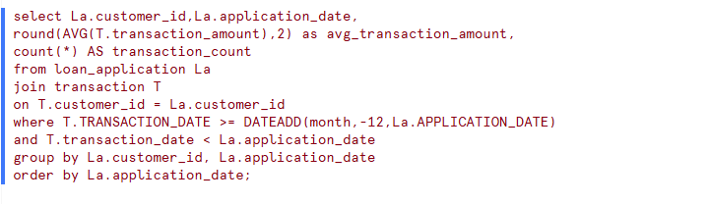
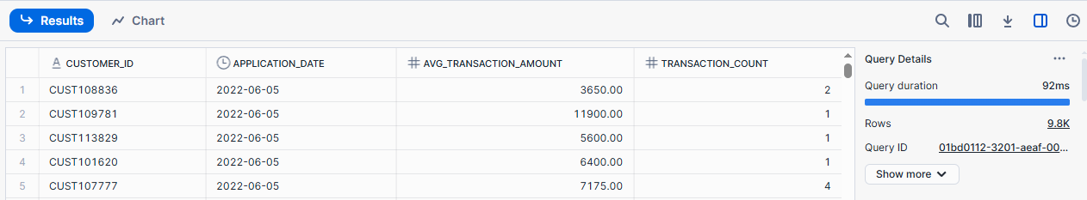
What is each customer's average transaction amount and count in the 12 months before applying for a loan?
Problem Statement
Code
Result

Slide 3
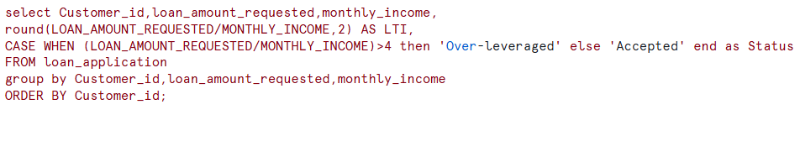
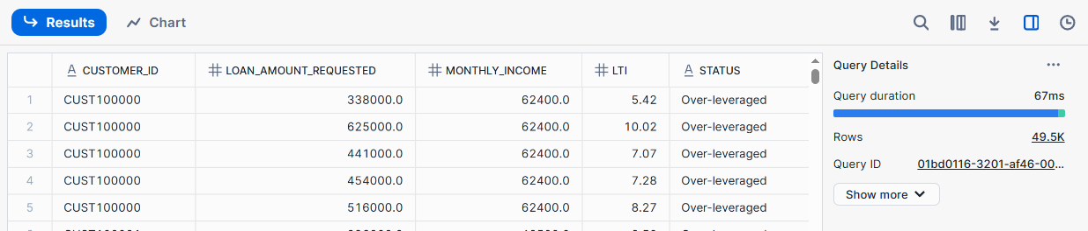
What is the loan-to-income ratio for each applicant, and who are over-leveraged?
Problem Statement
Code
Result

Slide 4
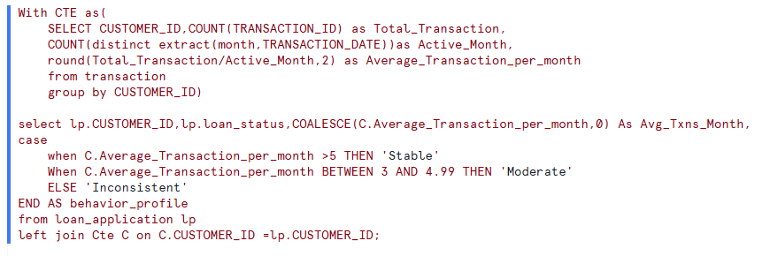
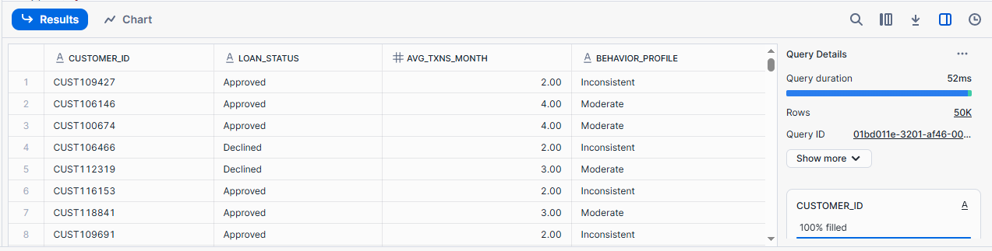
How frequently does each customer transact per month, and how consistent is their financial behavior?
Problem Statement
Code
Result

Slide 5
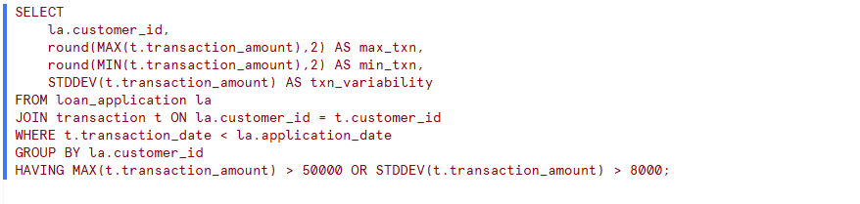
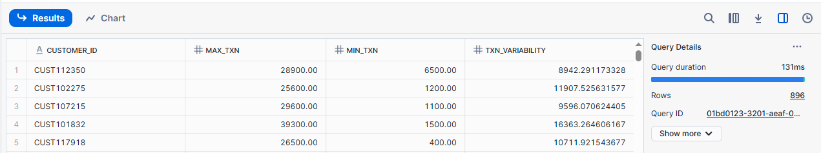
Which applicants show risky behavior like high withdrawals or highly variable transactions before applying?
Problem Statement
Code
Result

Slide 6
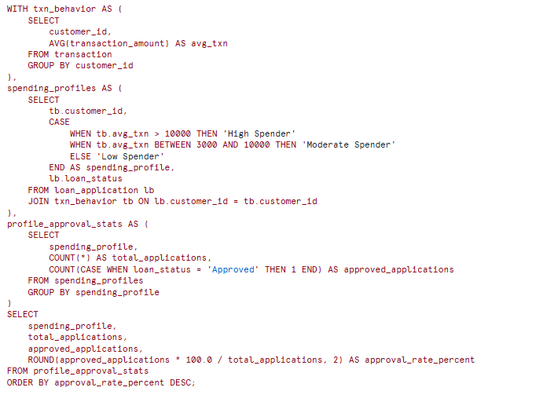
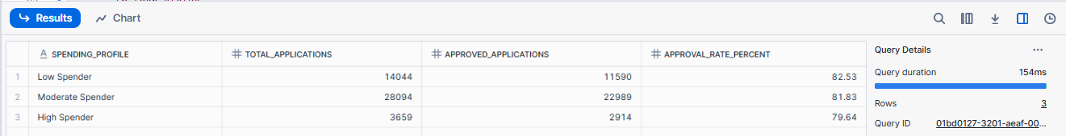
How does the loan approval rate differ based on customer spending profiles (e.g., High, Moderate, and Low Spenders)?
Problem Statement
Code
Result

Slide 7
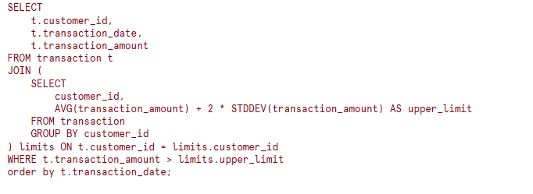
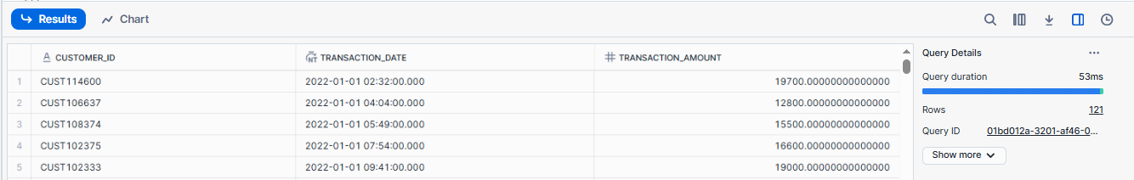
Are there any customers who made abnormal (outlier) transactions before applying for a loan?
Problem Statement
Code
Result

